Slide 1
HOW PURE IS YOUR WATER?
The Perfect Solution to Know Your Water Quality

Slide 2
The Problem We Present and Its Relevance
Water is one of our basic rights, and hence the deterioration of water quality and the diseases spread through water cannot be taken lightly.
After floods, the Invisible Water Crisis arises, where the unknown quality of water leads to many problems in the affected areas.
A person having to stay in an unfamiliar place cannot ensure whether the water he is using is safe enough.
Mothers, who tend to be protective of their kids, can’t always be sure their kids are safe from water borne diseases.

Slide 3
Our Solution
We’ve come up with the idea of an application that gets the real-time data from a set of sensors (for measuring pH, temperature, dissolved oxygen, bacteria, heavy metals, nutrients and turbidity). This can be accessed from users anywhere, and they can check if the water supplied from the outlets near them is safe to use.

Slide 4
How It Works
01
The data collected from the sensors placed at the inlet and outlet of the water authority purification systems are uploaded to IoT cloud using IoT cloud services.
02
The data obtained from the sensors is properly analysed and sent to the app SPLASH.
03
The water authority as well as common people could access these data from the app SPLASH, by searching for a specific location.
The data published contains details about the composition of various pollutants in the water source, their safe levels, and also tells if the water is safe for drinking purpose. SPLASH also allows you to compare previous days’ data and lets you know the estimated pollution rates for the following day.

Slide 5
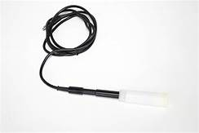
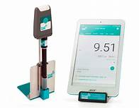
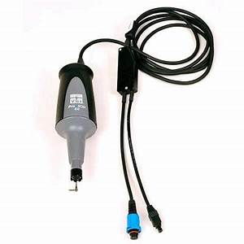
Components Used
DO Meter : Measures Dissolved Oxygen Level
Price : Rs 999
pH Meter : Measures pH level
Price : Rs 825
BOD Meter : Measures Biochemical Oxygen Demand
Price : Rs 2000

Slide 6
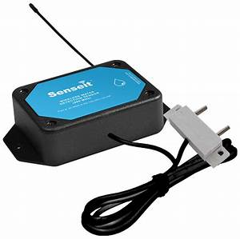
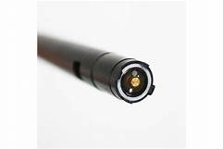
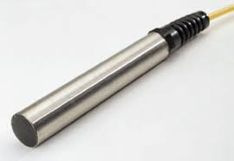
Components Used
Lead Detector : Measures Lead Level
Price : Rs 100
Fluoride Meter : Measures Fluoride Composition
Price : Rs 1000
Temperature Sensor : Measures Temperature
Price : Rs 130

Slide 7
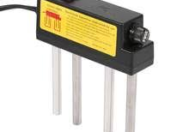
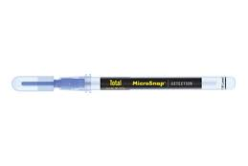
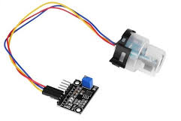
Components Used
Heavy Metals Sensor : Gives composition of heavy metalsl
Price : Rs 350
Microsnap : Measures levelof Ecoli and other bacteria
Price : Rs 400
Turbidity Sensor : Measures Turbidity
Price : Rs 999

Slide 8
About SPLASH
SPLASH allows the user to select his/her location from a list of places and displays the compositions of various pollutants present in their water source.
SPLASH also tells the user if the water is safe enough for drinking purposes along with displaying the safe level of composition of these pollutants.
The user can compare a days data with previous days’ data using SPLASH.
Expected pollutant compositions of the following day can also be analysed in SPLASH.

Slide 9
Conclusion
Solving the Invisible Water Crisis has not been given enough importance in our society although it created many complications for the local people after the recent flood of Kerala. We hope this project will be helpful during floods, droughts and other calamities, as well as in our day-to-day lives. SPLASH ensures that people don’t have to worry about the quality of their drinking water, and hopefully, would lead way to a world with a much lower rate of water borne diseases related deaths. SPLASH also aim at helping the Water Authority Department by providing them with details of pollutants in major water sources.

Slide 10

Thank you!
TEAM EPSILON
Kailas Nath R
Merin Babu
Dona Maria George.

